Slide 1

MACHINE LEARNING
Presented by S.S.G. Likhitha

Slide 2
Agenda
Introduction of Machine Learning?
Work Flow of ML
Types of Machine Learning
Applications of Machine Learning

Slide 3
INTRODUCTION OF MACHINE LEARNING

Slide 4
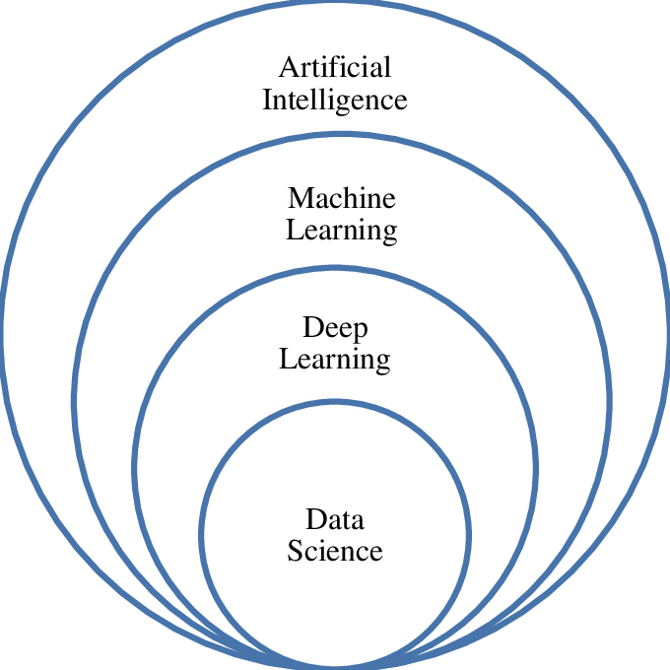
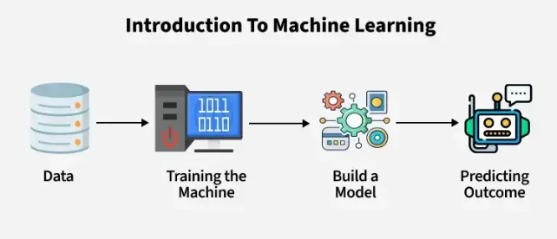
Machine Learning
Machine Learning (ML) is a branch of Artificial Intelligence (AI) that allows computers to learn from data and make decisions — without being directly programmed.
Machine Learning is used in many fields including healthcare (disease prediction), transportation (self-driving cars), finance (fraud detection), and entertainment (recommendation systems).
It uses examples and past data to make predictions or decisions.
It involves feeding data into algorithms to identify patterns and make predictions on new data.

Slide 5
Work Flow of Machine Learning:
Define the Problem Collect Data Explore & Preprocess Data
Train the Model Choose the Right Algorithm Split the Dataset
Evaluate the Model Deploy the Model
Define the Problem :
Identify what you are trying to solve. Is it a classification, regression, or clustering problem? Clearly understanding the objective is the foundation of a successful ML project.

Slide 6
Collect Data :
Gather relevant data from various sources (databases, files, APIs, sensors, etc.). This data will act as the learning material for your model.
3. Explore & Preprocess Data :
* Exploration: Understand data distributions, patterns, correlations, missing values.
* Preprocessing: Clean data, handle missing values, encode categorical variables, normalize features, etc
Split the Dataset :
Divide the data into training and testing sets (commonly 70–80% for training, 20–30% for testing) to evaluate performance on unseen data.
5. Choose the Right Algorithm : Select a suitable algorithm based on the problem type and dataset (e.g., Linear Regression, Decision Trees, SVM, KNN, etc.).

Slide 7
6. Evaluate the Model : Test the model using the testing dataset. Use performance metrics like accuracy, precision, recall, RMSE, etc., depending on the task.
7. Deploy the Model : Once performance is satisfactory, deploy the model into a production environment (web app, mobile app, cloud, etc.) to make real-time predictions.

Slide 8
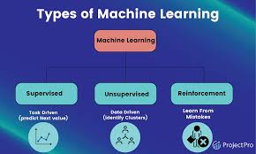
Types of ML
There are several types of machine learning, each with special characteristics and applications. Some of the main types of machine learning algorithms are as follows :
1. Supervised Machine Learning
2. Unsupervised Machine Learning
3. Reinforcement Learning

Slide 9
SUPERVISED LEARNING
Supervised Learning is the most commonly used type of Machine Learning. In this method, the model learns from a labeled dataset, where both the input and correct output (called labels) are provided.
How It Works :
We give the model input data (X) along with the correct answer (Y).
The model learns the relationship between input and output.
Once trained, it can predict outputs for new inputs.

Slide 10
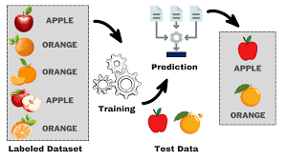
Example of Supervised Learning :

Slide 11
Work Flow of Supervised Learning :
Collect Data Get labeled data with inputs and outputs
Split Data Separate into training and testing sets
Choose Algorithm Pick the best ML method based on the problem
Train Model Let the model learn from training data
Test Model Measure performance on unseen test data
Predict New Data Use trained model to predict outputs for new inputs

Slide 12
Types of Supervised Learning:
There are two main types of supervised learning:
1. Regression 2. Classification
What is Regression?
Regression is a type of supervised learning used when the output (or label) is a continuous numeric value. The goal is to predict real or continuous numbers based on one or more input features.
How Regression Works
In regression, the machine learning model tries to find a relationship (usually mathematical) between the input variables (X) and the output variable (Y).
For example :
Predicting a person’s weight based on their height.
Predicting a house price based on size, location, number of rooms.
Common Algorithms for Regression :
Linear Regression 2. Decision Tree Regression .

Slide 13
What is Classification ?
Classification is a type of supervised learning where the output variable is a category or class label. The model learns to assign new inputs into one of several predefined classes.
How Classification Works
The algorithm is trained on data where each input is labeled with a class (like "cat" or "dog", or "yes" or "no"). The model learns patterns and boundaries between different classes. Once trained, it can predict the class of a new, unseen data point.
For example : Common Algorithms for Classification :
Is this email spam or not spam? 1. K-Nearest Neighbors(KNN)
Is the patient diabetic or not? 2. Decision Tree Classifier
3. Random Forest Classifier

Slide 14
UNSUPERVISED LEARNING
Unsupervised Learning is a type of machine learning where the model learns patterns without any labeled output. Unlike supervised learning, we do not provide the correct answers. The algorithm tries to find hidden patterns or groupings in the input data.
How It Works :
We give the model input data (X) along with the correct answer (Y).
The model learns the relationship between input and output.
Once trained, it can predict outputs for new inputs.

Slide 15
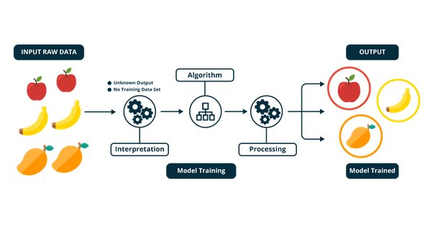
Example of Unsupervised Learning :

Slide 16
Work Flow of Unsupervised Learning :
Collect Data Gather input data without any labels (only features, no output values)
Preprocess Data Clean, normalize, and prepare data for better learning
Choose Algorithm Select an appropriate method like K-Means, DBSCAN, or PCA
Train Model Allow the model to find patterns, structures, or clusters in the data.
Analyze Results Interpret the discovered groups or features
Apply Insights Use the output for decision-making, visualization, or further ML

Slide 17
Types of Unsupervised Learning:
There are three main types of Unsupervised learning:
Clustering
2. Dimensionality Reduction
Association Rule Learning
What is Clustering ?
Clustering is the process of grouping similar data points together based on their features — without any labels.
Real-World Examples : Algorithms :
Customer segmentation in marketing 1. K- Means Clustering(Groups data into K –clusters)
(Organizing images based on content similarity 2. Hierarchical Clustering (Builds a tree of clusters)
3. DBSCAN (Clusters of any shape )

Slide 18
What is Dimensionality Reduction ?
This type finds interesting relationships or associations among variables in large databases.
💡 Real-World Examples :
Image compression
Visualizing datasets with hundreds of features
Speeding up training time for machine learning models
🔧 Popular Algorithms :
PCA (Principal Component Analysis): Projects data into a lower dimension
t-SNE: Useful for visualizing clusters in 2D/3D
Autoencoders: Neural networks that learn compact representations of data

Slide 19
What is Association Rule Learning ?
It is the technique of reducing the number of input variables (features) in a dataset while preserving its essential structure.
💡 Real-World Examples :
Market Basket Analysis: "People who buy bread also buy butter"
Cross-selling and recommendation systems
Inventory planning
🔧 Popular Algorithms :
Apriori: Finds frequent itemsets and generates rules
FP-Growth: More efficient than Apriori for large datasets
ECLAT: Uses vertical data format for rule generation

Slide 20
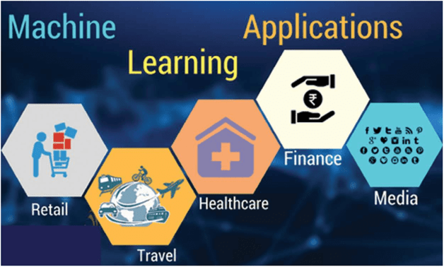
Applications
20

Slide 21
Thank you

